Slide 1
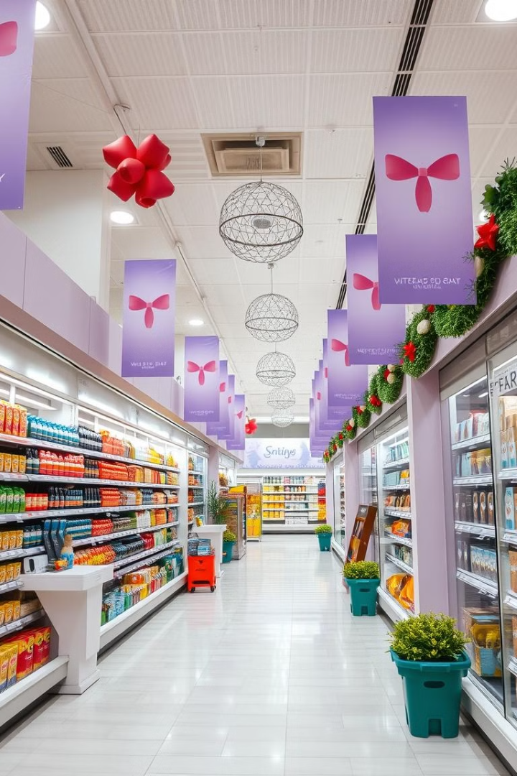


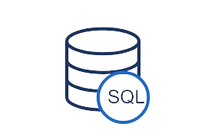
AtliQ Mart: Festive Promotions Analysis

Slide 2
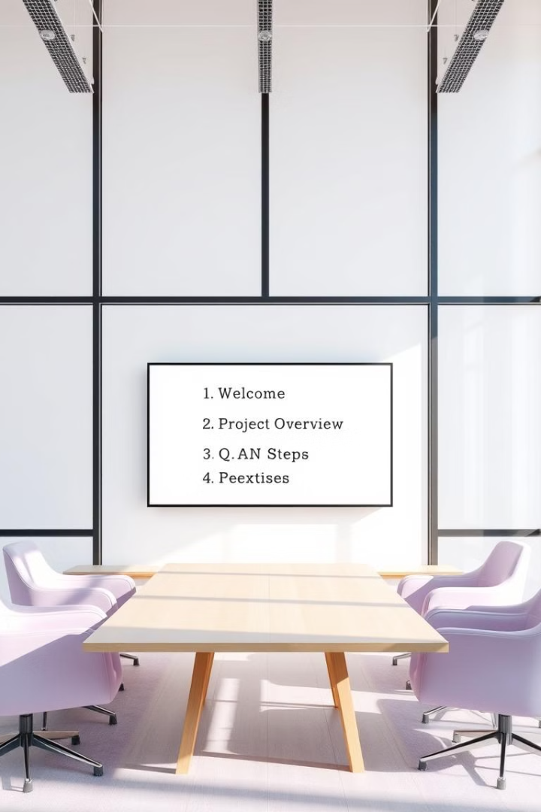
Agenda
1
Company Background
2
Problem Statement
Explanation of the challenge faced by the sales director.
Overview of AtliQ Mart's presence and operations in southern India.
3
Project Overview
4
Insights and Dashboard
Outline of the analysis objectives and focus areas.
Presentation of key findings and interactive data visualization.

Slide 3
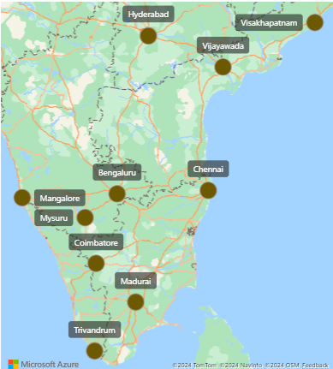
Company Background
Store Network
AtliQ Mart operates 50 supermarkets across 10 major cities in southern India.

Slide 4

Company Background
Product Categories
Promotional Periods
Offers diverse range including groceries, home care, personal care, Home appliances and Combo1.
Focused on Diwali 2023 (Nov 12-18) and Sankranti 2024 (Jan 10-16) festivals.

Slide 5

Problem Statement
1
Promotional Campaign Analysis
All their 50 stores ran a massive promotion during the Diwali 2023 and Sankranti 2024 (festive time in India) on their AtliQ branded products.
Now the sales director wants to understand which promotions did well and which did not so that they can make informed decisions for their next promotional period..
2
Task Delegation
As a curious data analyst, is assigned to conduct the analysis.

Slide 6


Project Overview
Objective
Focus Areas
Conduct comprehensive analysis of AtliQ Mart's festive promotions and create performance reports.
Analyze campaigns, events, and promotion types across stores and product categories.
Data Sources
Leverage information from dim_campaigns, dim_products, dim_stores, and fact_events tables.

Slide 7
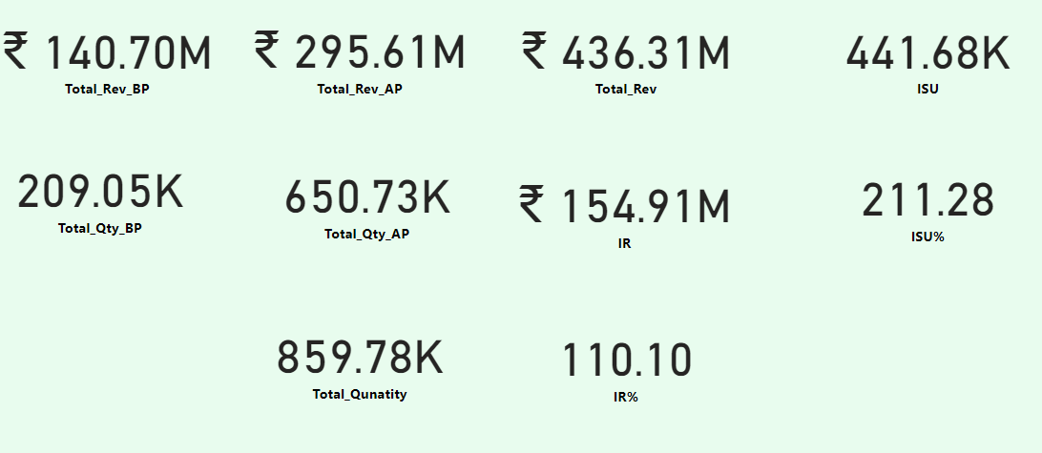
Insights by Revenue
Metric
Before Promotion
After Promotion
Total
Bengaluru Revenue
33M
38M
71M
Combo 1 Category
67M
159M
226M
500 Cashback Promotion
67M
158M
225M

Slide 8



Insights by Quantity
Grocery & Staples
Other Categories
Overall Impact
Before promotion: 127K units.
After promotion: 377K units. Significant increase of 250K units.
Similar positive trends observed in home care, personal care, and appliances categories.
Promotions drove substantial quantity increases across all product categories.

Slide 9
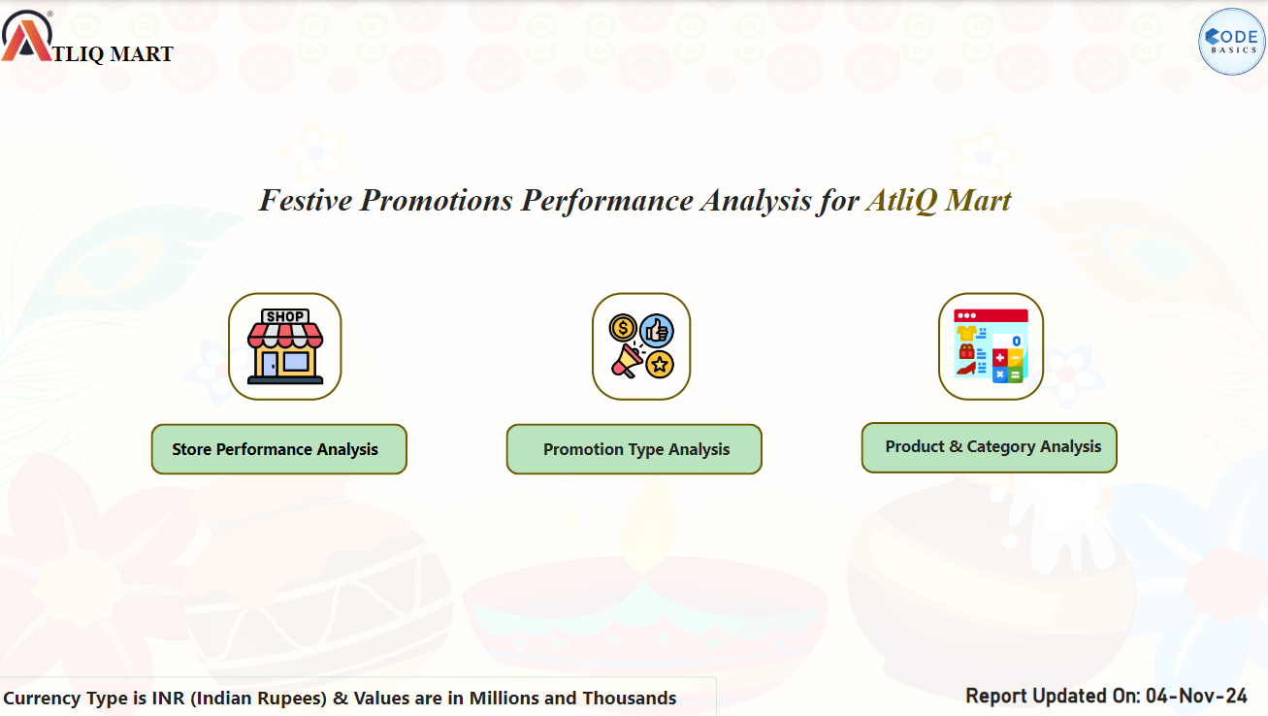
Dashboard
Click Here For Dashboard

Slide 10
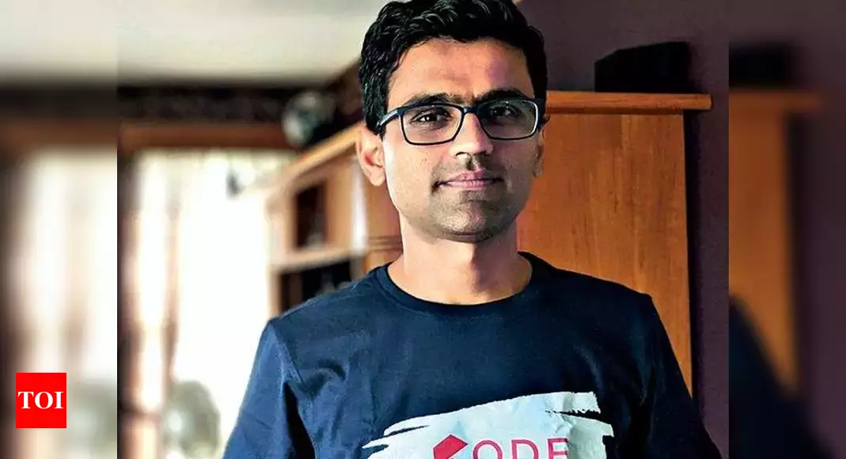

Thank You
HEMANAND SIR
DHAVAL PATEL SIR

